Slide 1


Lesson 4 Family business
UNIT 1

Slide 2
What words come into your mind when you say family? Draw a mind map and share your answers with the class.
FAMILY

Slide 3
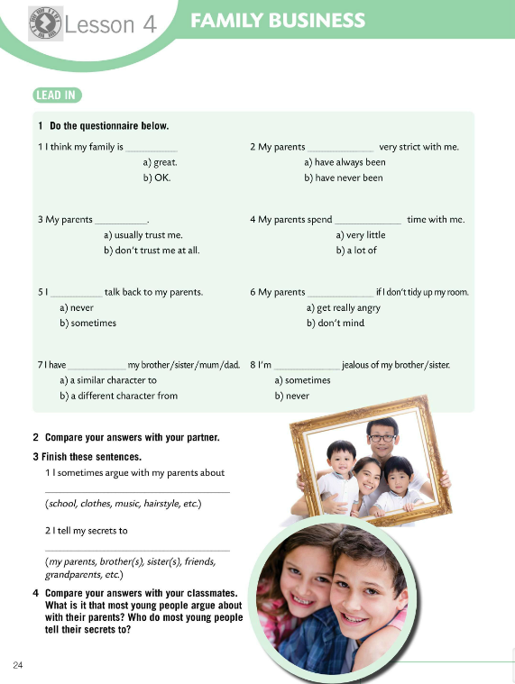
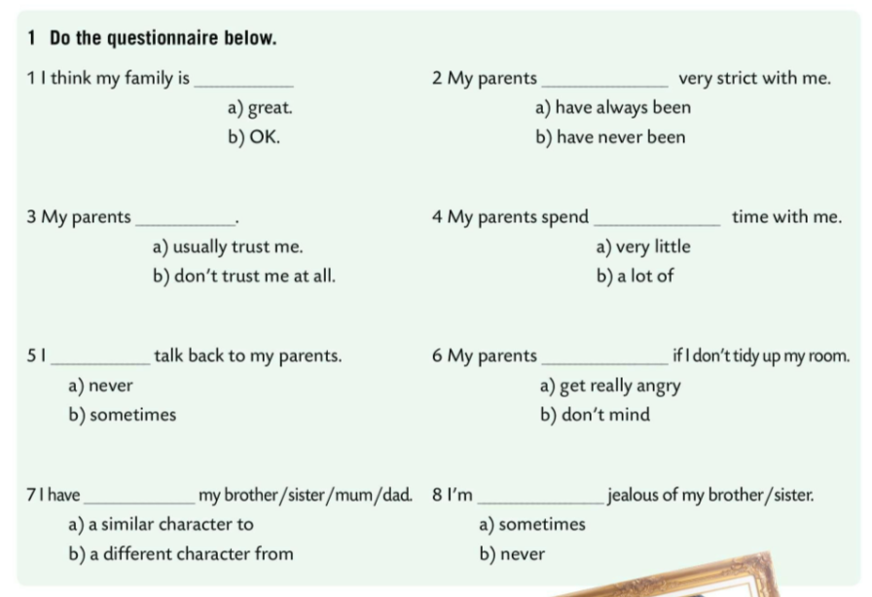
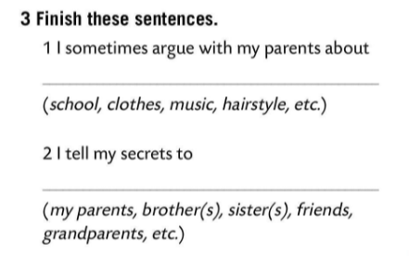
Do the questionnaire in Task 1.
Compare your answers with your partner.
Finish sentences in Task 3.
Compare your answers with your classmates. What is it that most young people argue about with their parents?
Who do most young people tell their secrets to?

Slide 4
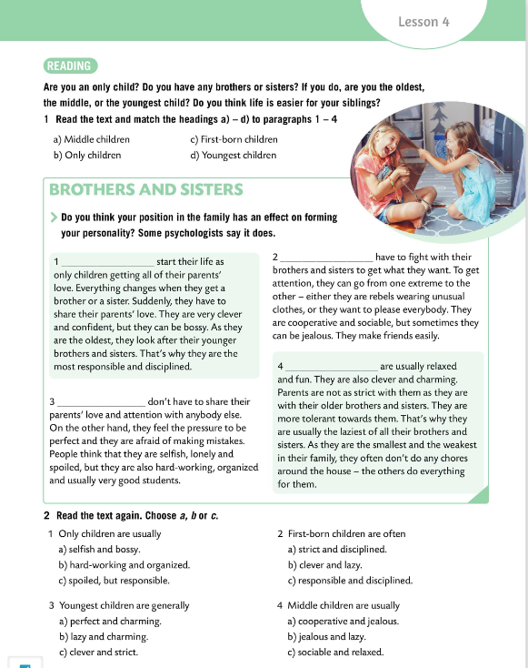
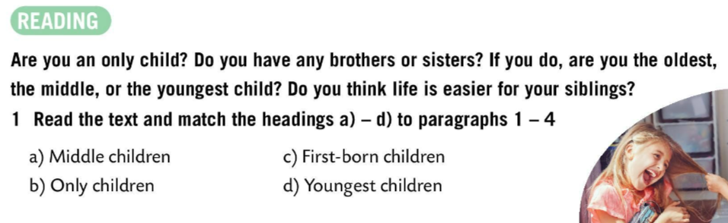
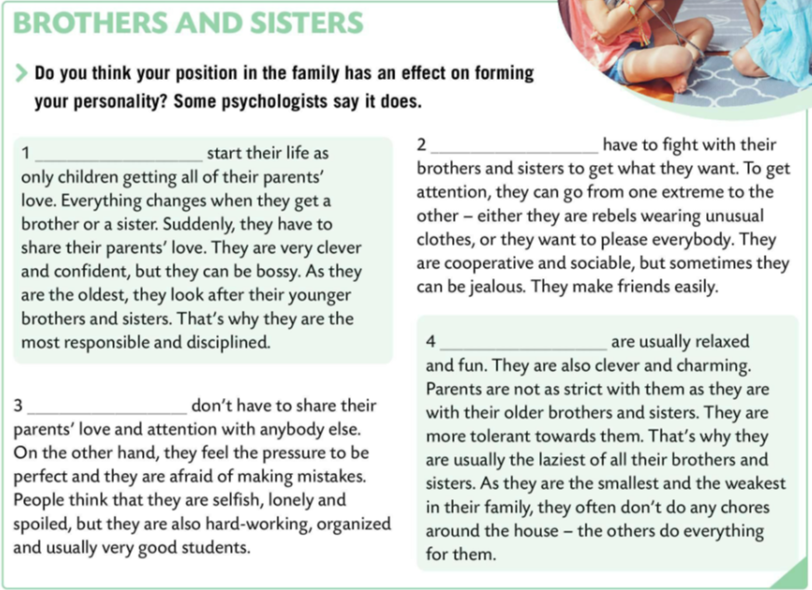
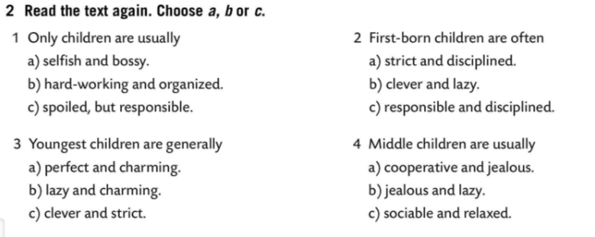
Are you an only child?
Do you have brothers or sisters? If you do, are you the oldest, the middle, or the youngest child?
Do you think life is easier for your sibling?
Read the text and match the headings a) – d) to paragraphs 1 – 4.
c) First-born children
a) Middle children
Check.
d) Youngest children
b) Only children
Read the text again. Choose a, b or c.
Check.

Slide 5
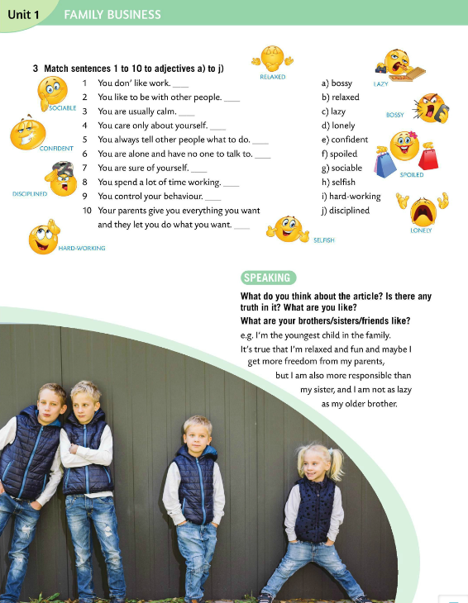
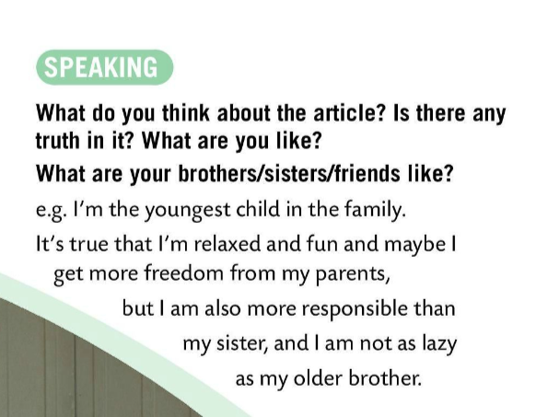
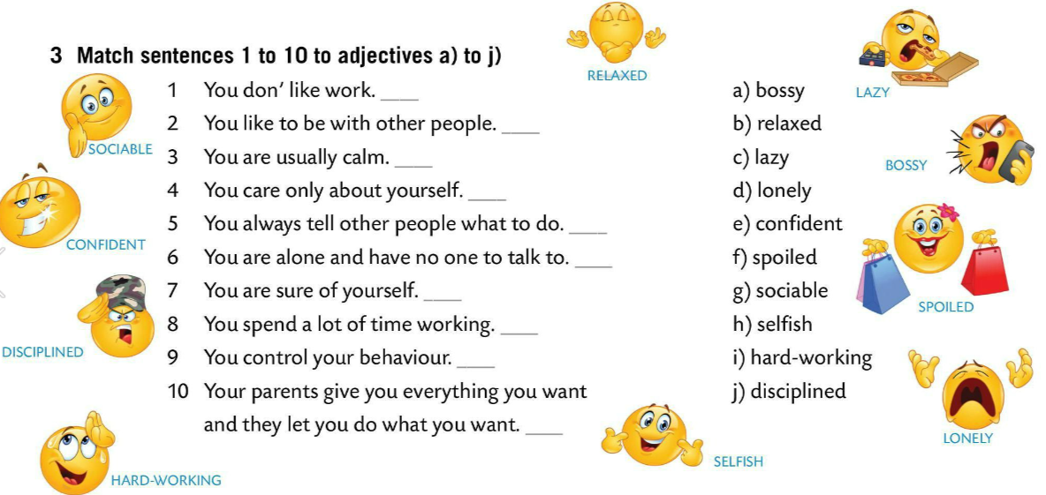
Match sentences 1 to 10 to adjectives a) to j).
c)
Check.
g)
b)
h)
a)
d)
e)
i)
What do you think about the article? Is there any truth in it? What are you like?
j)
f)
What are your brothers and sisters like?

Slide 6
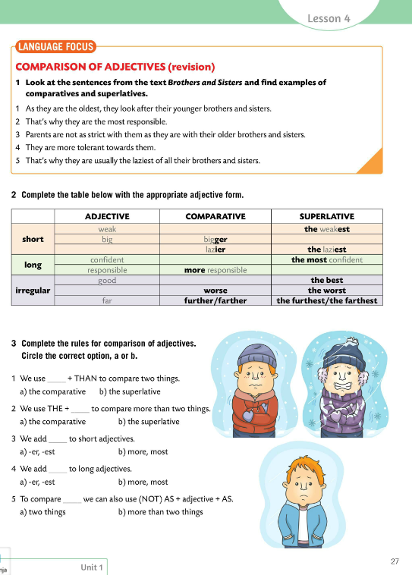
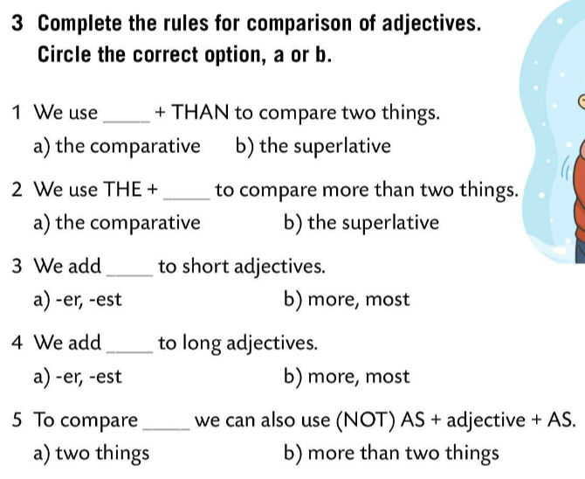
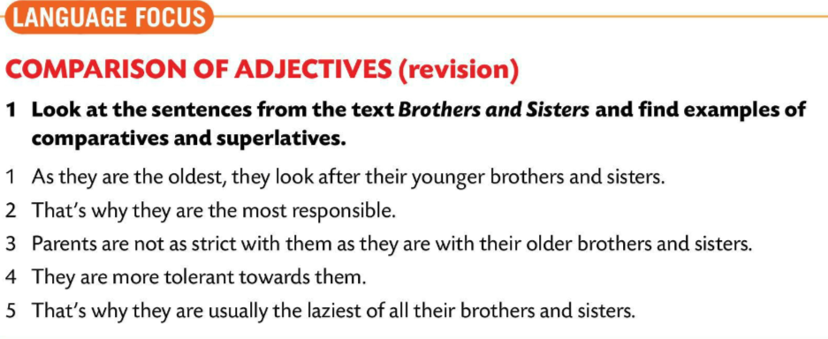
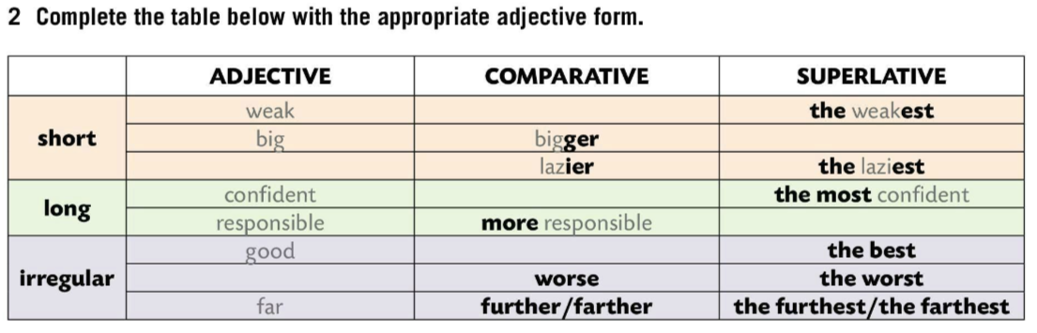
LANGUAGE FOCUS
Look at the sentences from the text Brothers and Sisters and find examples of comparatives and superlatives.
weaker
Complete the table below with the appropriate adjective form.
the biggest
lazy
more confident
the most responsible
better
Check.
bad
Complete the rules for comparison of adjectives. Circle the correct option, a) or b).
Check.

Slide 7
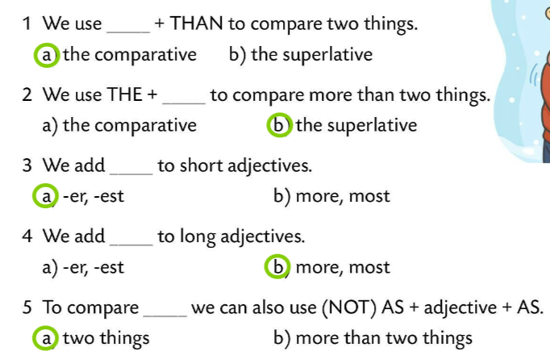
We use the comparative + THAN to compare TWO things.
Komparativ + THAN koristimo kada uspoređujemo dvije stvari.
We add –er to short adjectives.
Kratkim pridjevima dodajemo nastavak –er.
long → longer
We add more to the long adjectives.
Ispred dugačkih pridjeva dodajemo riječ more.
e.g. expensive → more expensive

Slide 8
We use THE + superlative to compare more than TWO things.
THE i superlativ koristimo kada uspoređujemo više od dvije stvari.
Short adjectives
We add THE …–est to short adjectives.
Kratkim pridjevima dodajemoTHE... –EST.
long → THE longest
Long adjectives
We add the most to the long adjectives./ Ispred dugačkih pridjeva dodajemo riječi the most. → THE most expensive
To compare two things we can also use (NOT) AS + adjective +AS.
Za uspoređivanje dviju stvari možemo koristiti (NOT) AS + pridjev + AS.
He is not as strong as his brother.

Slide 9
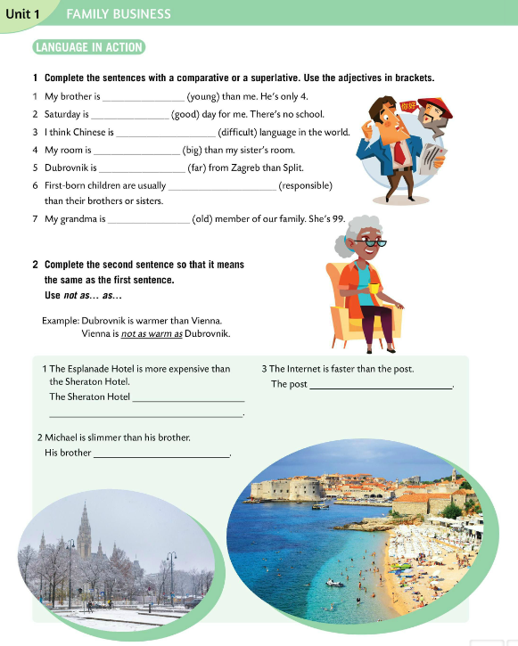
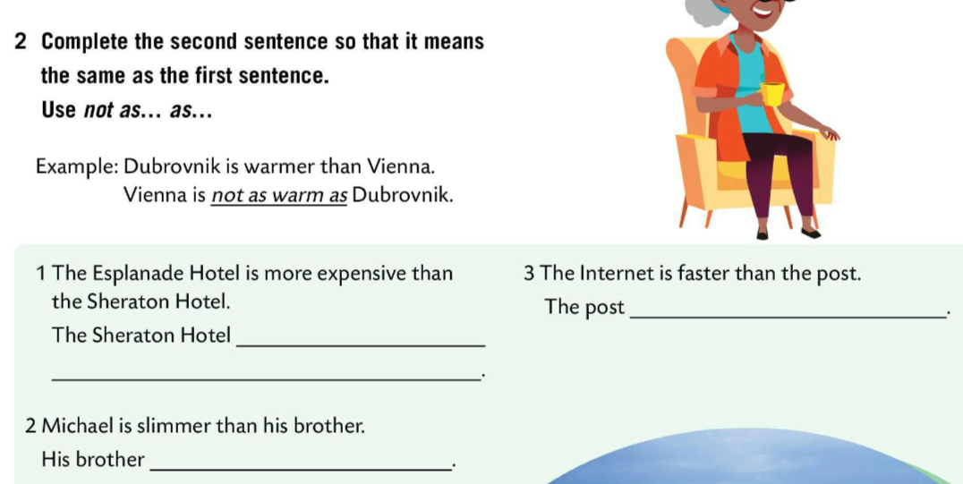
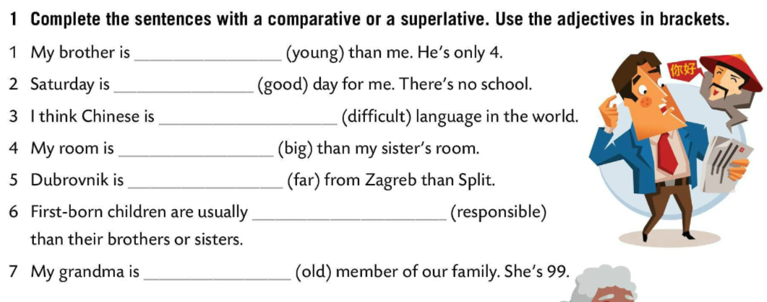
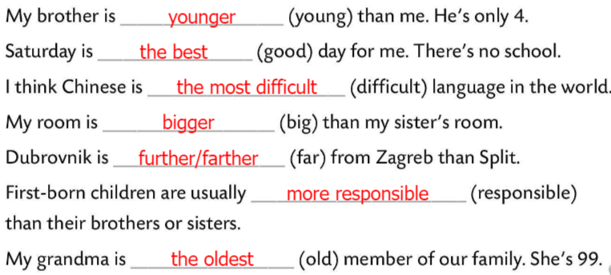
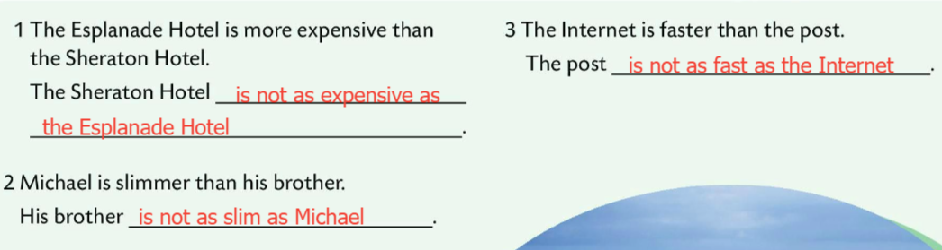
Complete the sentences with a comparative or a superlative. Use the adjectives in the brackets.
Check.
Complete the second sentence so that it means the same as the first sentence.
Use not as … as …
Check.

Slide 10
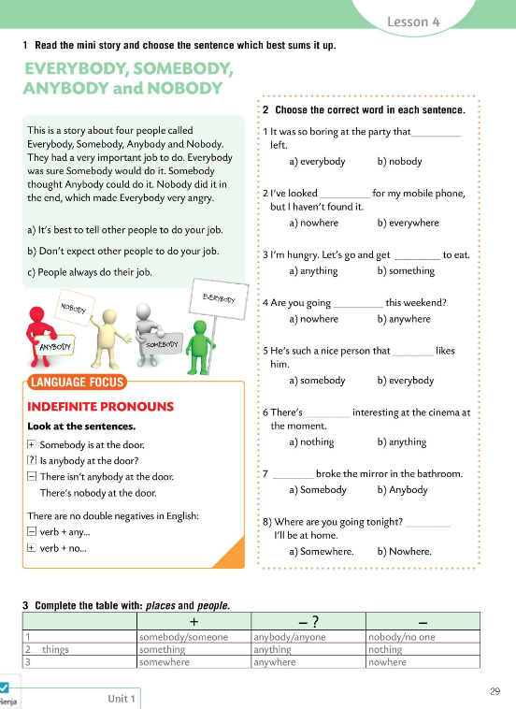
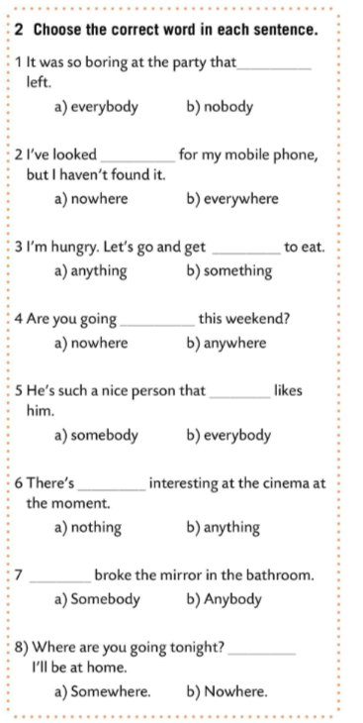
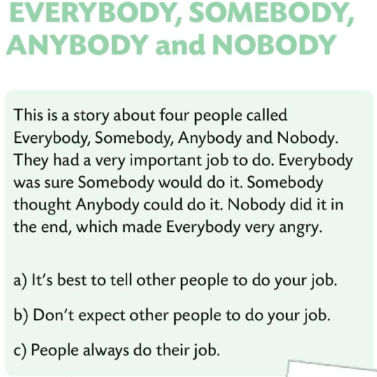
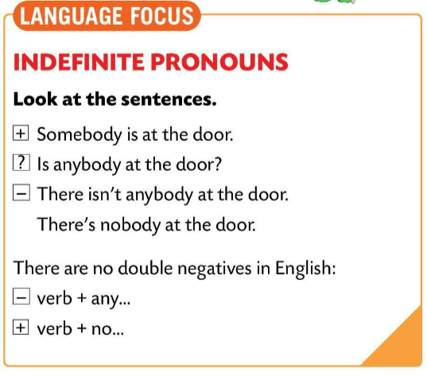
Read the mini story and choose the sentences which best sums it up.
Check.
Choose the correct word in each sentence.
Check.
LANGUAGE FOCUS
Indefinite pronouns are pronouns that do not refer to any person, amount, or thing. Neodređene zamjenice se odnose na neodređenu osobu, stvar ili količinu.
somebody, anybody, nobody, everybody

Slide 11
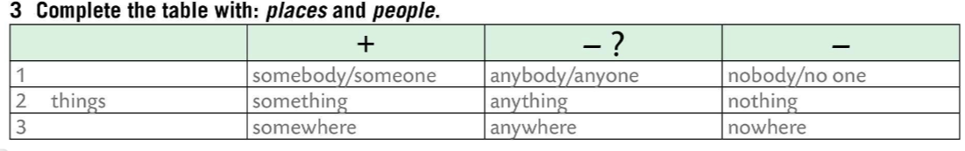
Look at the sentences. What can you notice?
Somebody is at the door. Netko je pred vratima.
Is anybody at the door? Je li tko pred vratima?
There isn’t anybody at the door. OR There is nobody at the door. Nitko nije pred vratima.
There are no double negatives in English. U engleskom jeziku nema dvostrukih negacija.
(There isn’t nothing in the box.)
We form negative sentences with verb + any… Niječne rečenice tvorimo tako što ćemo glagolu dodati any…
There isn’t anything in the box.
We can also form negative sentences with verb + no../ Niječne rečenice možemo tvoriti i tako što ćemo dodati glagolu no…
There is nothing in the box.
people
places
Complete the table with: places and people.
Check.

Slide 12
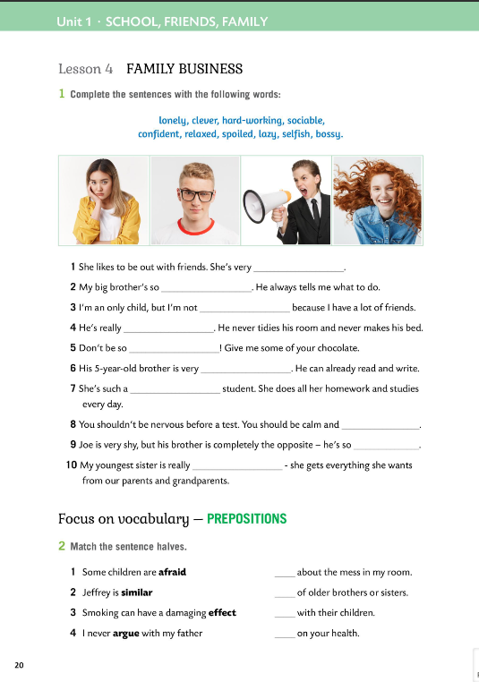

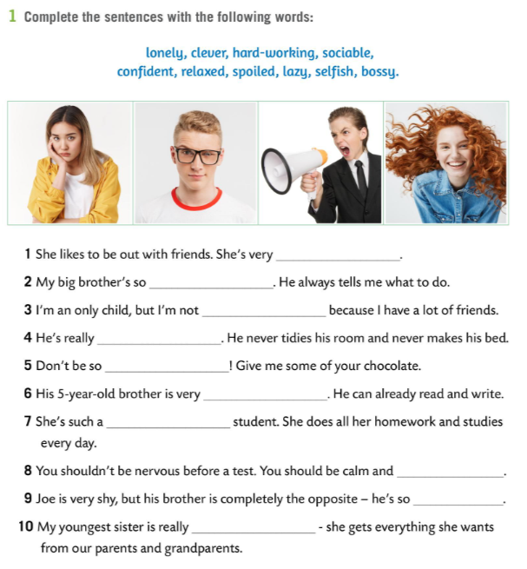
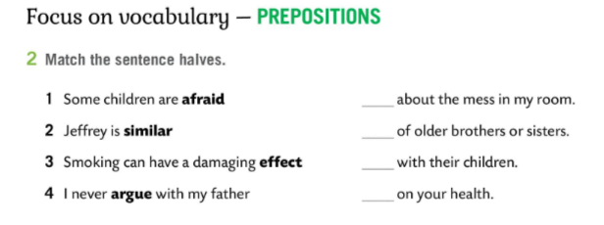

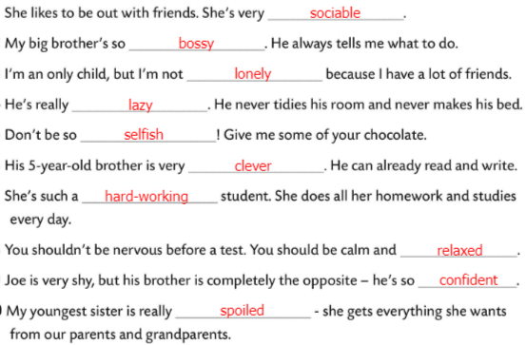
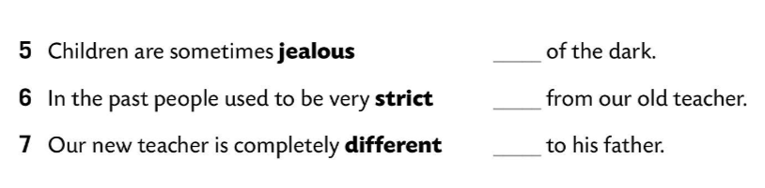

Workbook, page 20
Complete the sentences with the words from Task 1.
Check.
Match the sentence halves.
Check.

Slide 13
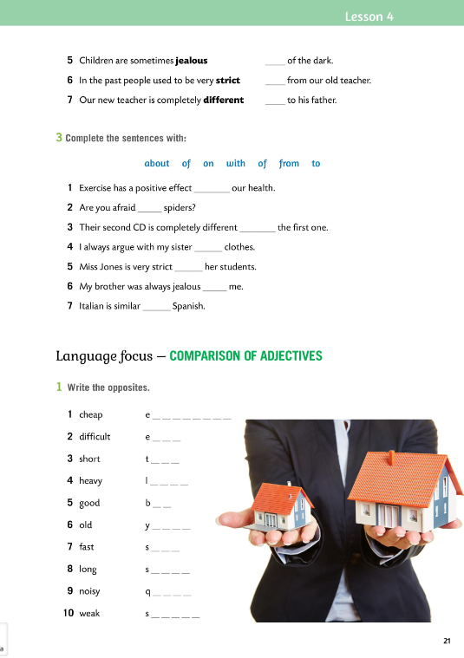
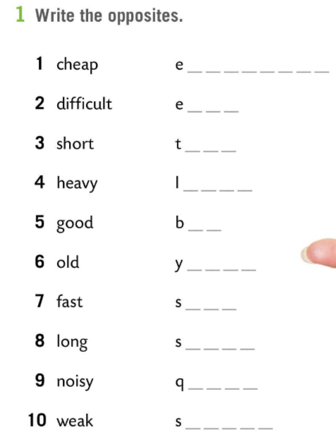
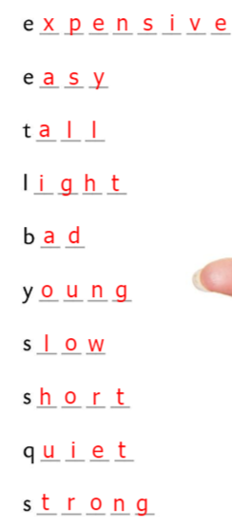
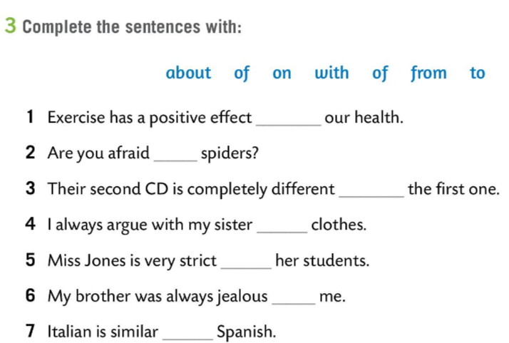
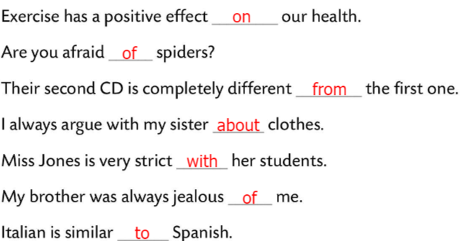
Workbook, page 21
Complete the sentences with the words from Task 3.
Check.
Write the opposites.
Check.

Slide 14
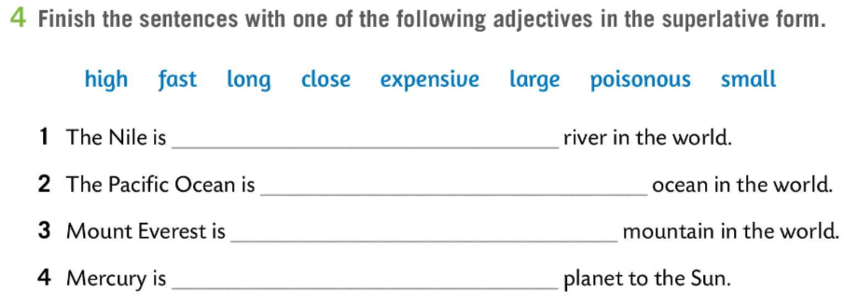
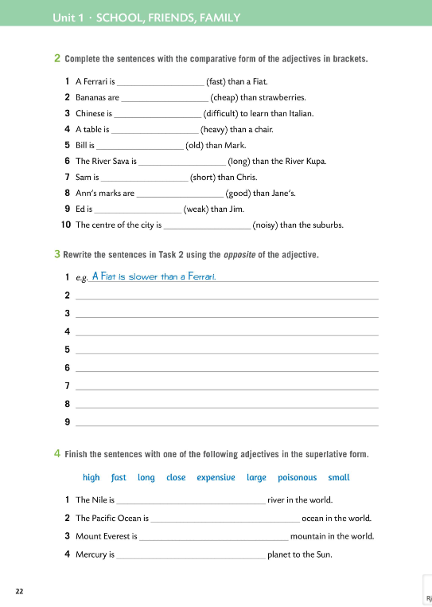
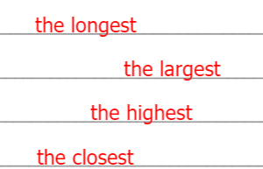
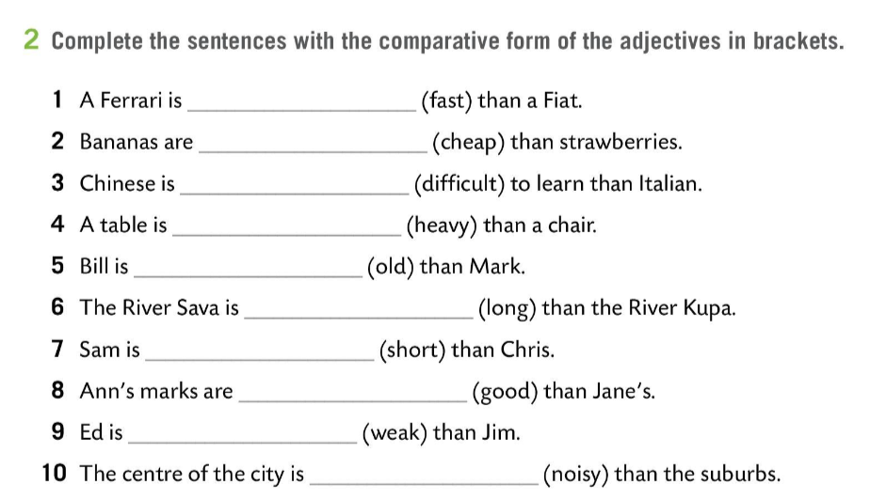
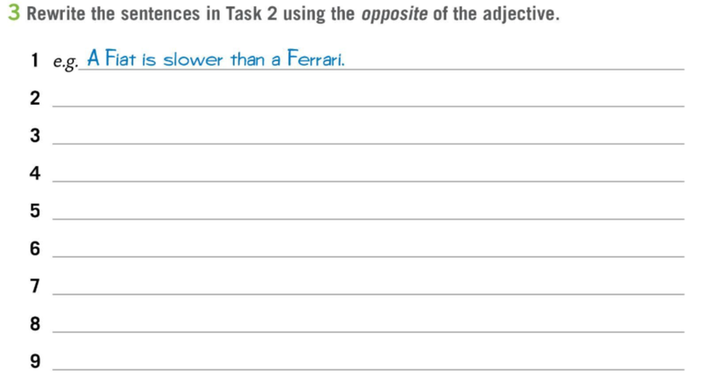
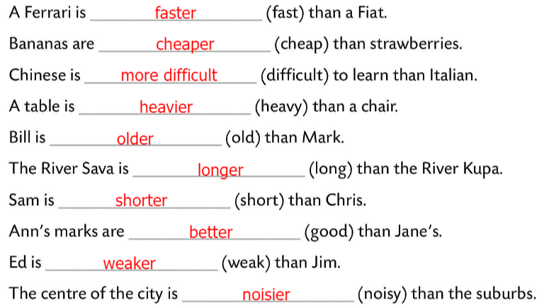
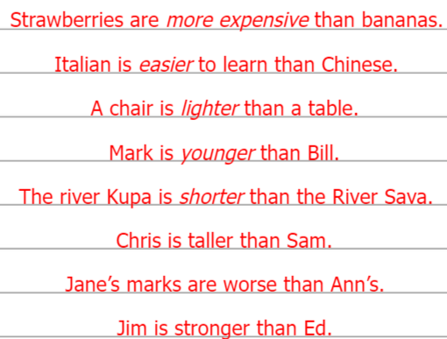
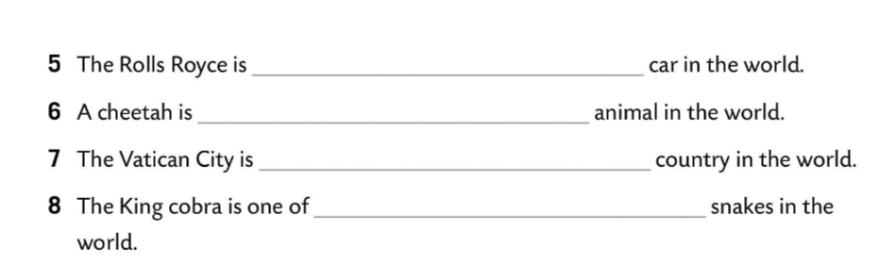
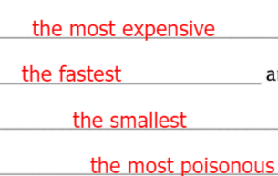
Workbook, page 22
Complete the sentences with the comparative form of the adjectives in the brackets.
Check.
Rewrite the sentences in Task 2 using the opposite of the adjective.
Check.
Fill in the sentences with one of the adjectives in the superlative form.
Check.

Slide 15
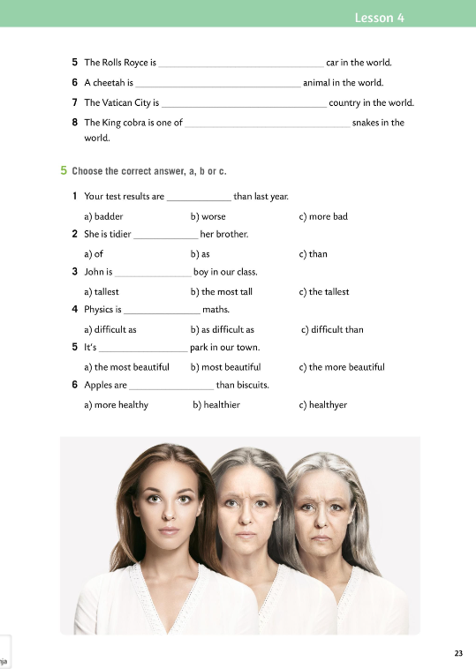
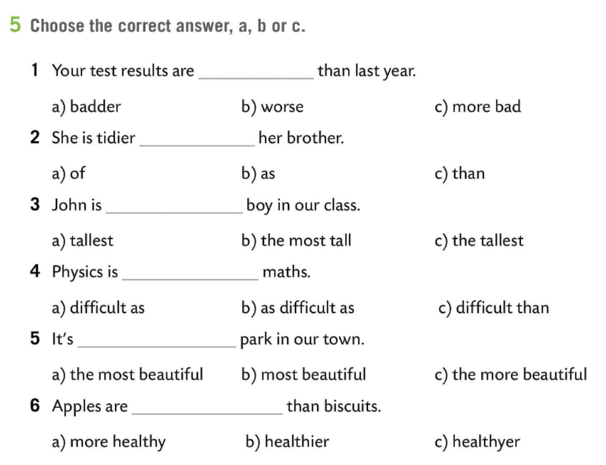
Workbook, page 23
Choose the correct answer: a, b or c.
Check.

Slide 16
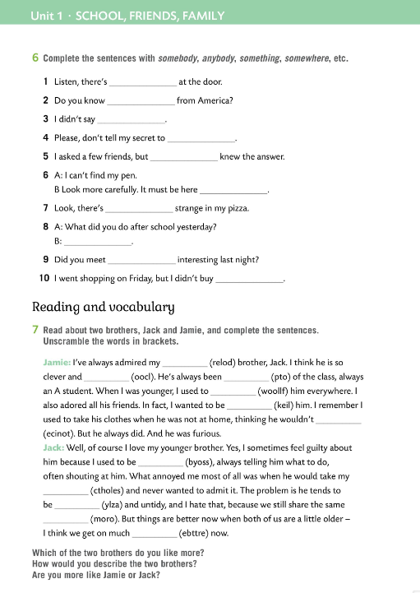
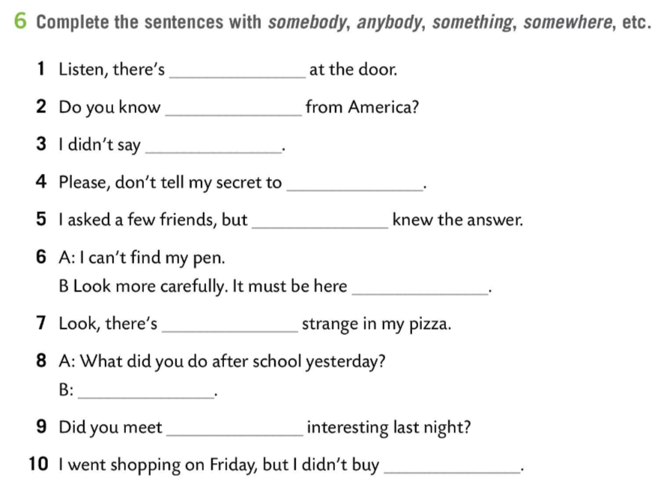
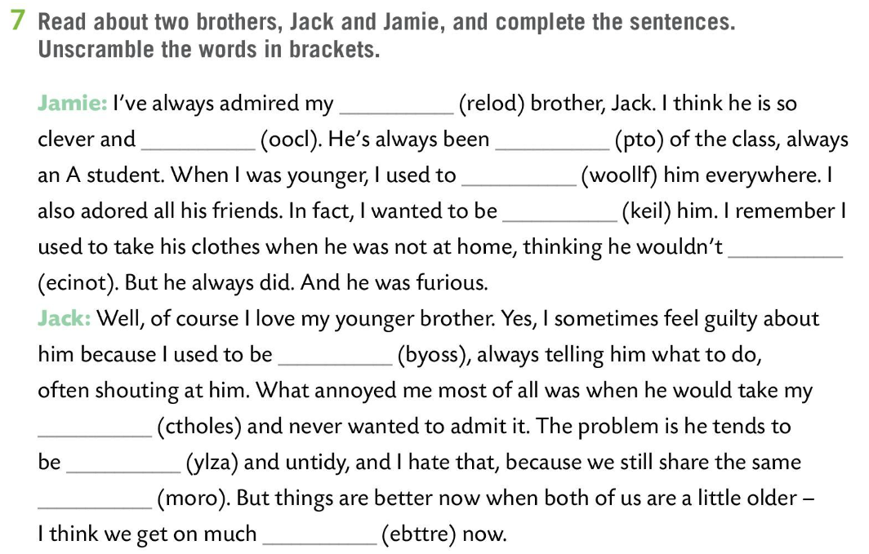
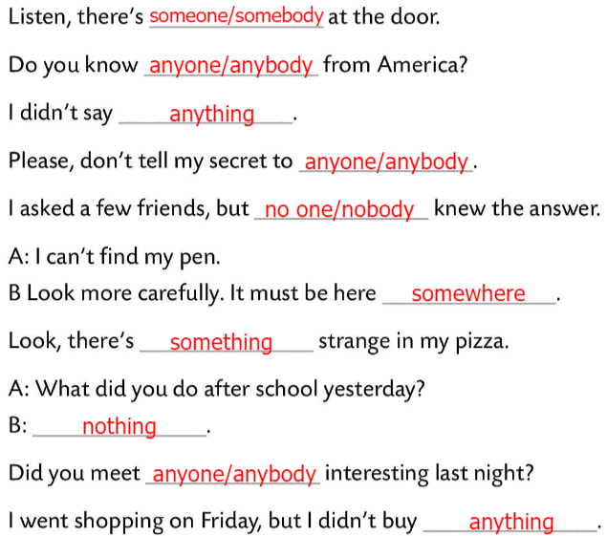

Workbook, page 24
Complete the sentences with somebody, anybody, something, somewhere, etc.
Check.
Read about two brothers, Jack and Jamie, and complete the sentences. Unscramble the words in brackets.
Check.
Which of the two brothers do you like more?
How would you describe the two brothers? Are you more like Jamie or Jack?

